Slide 1
CREDIT EDA CASE STUDY
By S VISHWAS YEDIDYA

Slide 2
Categorical Univariate analysis

Slide 3

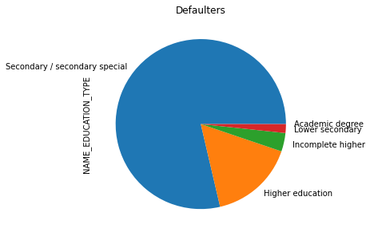
Distribution of EDUCATION TYPE
Points to be concluded from the graph on the right side.
Secondary/Secondary special counts are higher.
Followed by higher education people.

Slide 4
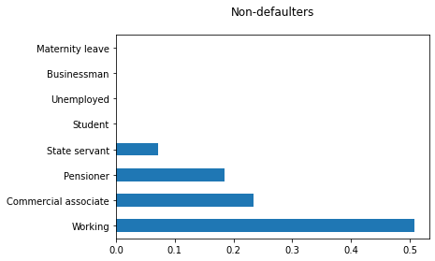
Distribution of income type
Points to be concluded from the graph on the right.
For income type ‘working’, ’commercial associate’, and ‘Pensioner’ the number of credits are higher than others.
Less number of credits for income type ‘student’ ,‘Businessman’ and ‘Maternity leave’.

Slide 5
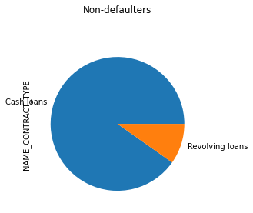
Distribution for contract type
Points to be concluded from the graph on the right.
For contract type ‘cash loans’ is having higher number of credits than ‘Revolving loans’ contract type.

Slide 6
Distribution EDUCATION TYPE
Points to be concluded from the graph on the right side.
Seems to be similar to taget 0 conditions.
With Secondary/Secondary special highest and Academic degree the lowest

Slide 7
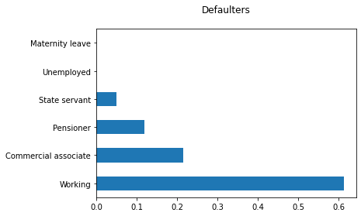
Distribution of income type
Points to be concluded from the graph on the right side.
For income type ‘working’, ’commercial associate’, and Pensioner’ the number of credits are higher than other i.e. ‘Maternity leave.
Less number of credits for income type ‘Maternity leave’.
For type 1: There is no income type for ‘student’, ‘Unemployed’and ‘Businessman’ which means they don’t do any late payments.

Slide 8
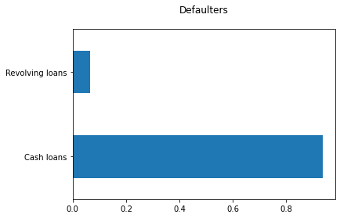
Distribution for contract type
Points to be concluded from the graph on the right.
For contract type ‘cash loans’ is having higher number of credits than ‘Revolving loans’ contract type.

Slide 9
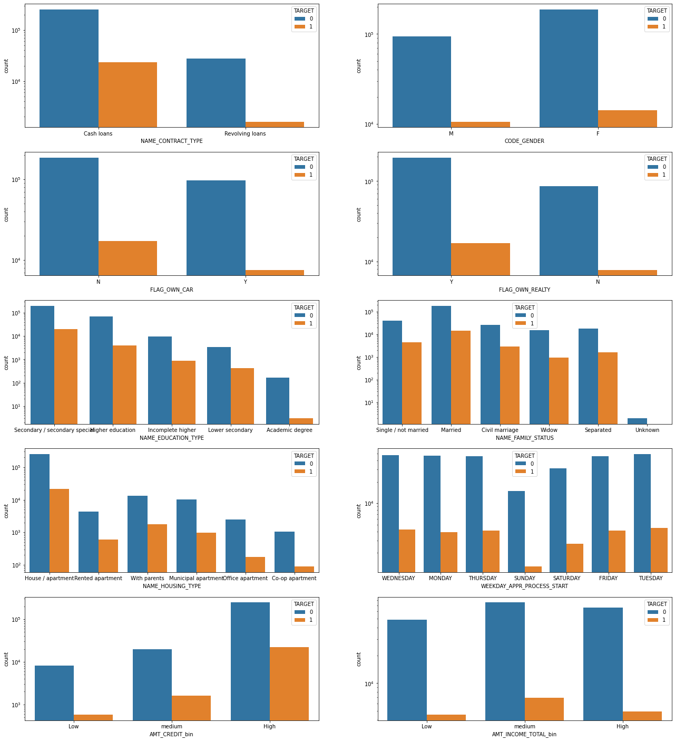
CONSIDERING 10 CATEGORICAL COLUMNS
Points to be concluded from the graph on the right.
People with Medium total income are more likely to default
People tend to take more cash loans, and default percentage of revolving loans is less
We can say more married people tend to take more Loan as compaired to other categories
People with real estate tends to take more loans
People who started application process on sunday are less likely to default

Slide 10
Categorical Univariate analysis for variables target 0

Slide 11

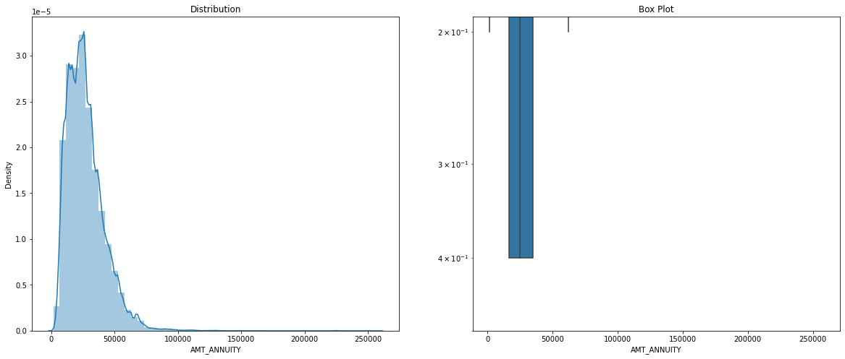
CONTINUOUS NUMERICAL VARIABLES AMT_ANNUITY

Slide 12
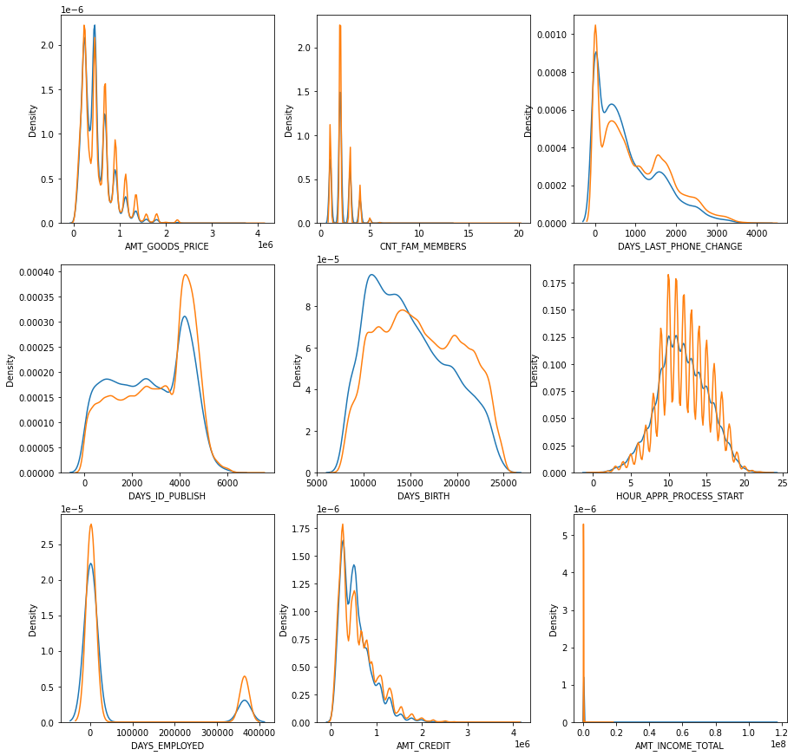
Considering 9 continous numerical columns
People with lower total income are more likely to default
People who just got employed tends to take more loans
People who retired tends to take more loans
People with age between 27yrs(10000-days) and 41(15000-days) yrs tend to take more loans
Nuclear family tends to take more loans
For less goods amount people take loans
Low amount annuity has high number of loans

Slide 13
Bivariate analysis

Slide 14
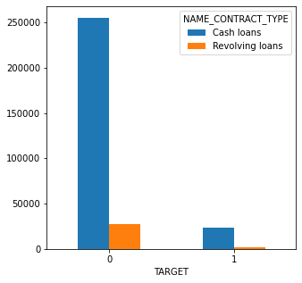
NAME_CONTRACT_TYPE
Few points can be concluded from the graph.
Cash loans are way higher than revolving loans
Cash loans are especially higher in target 0

Slide 15
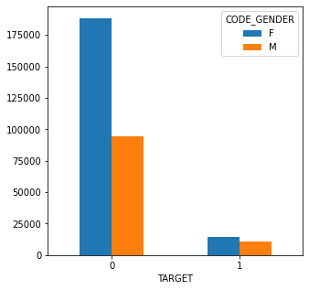
CODE_GENDER
Few points can be concluded from the graph.
Females have higher tenaity to take loans
Target 0 have significantly more number of females taking loans

Slide 16
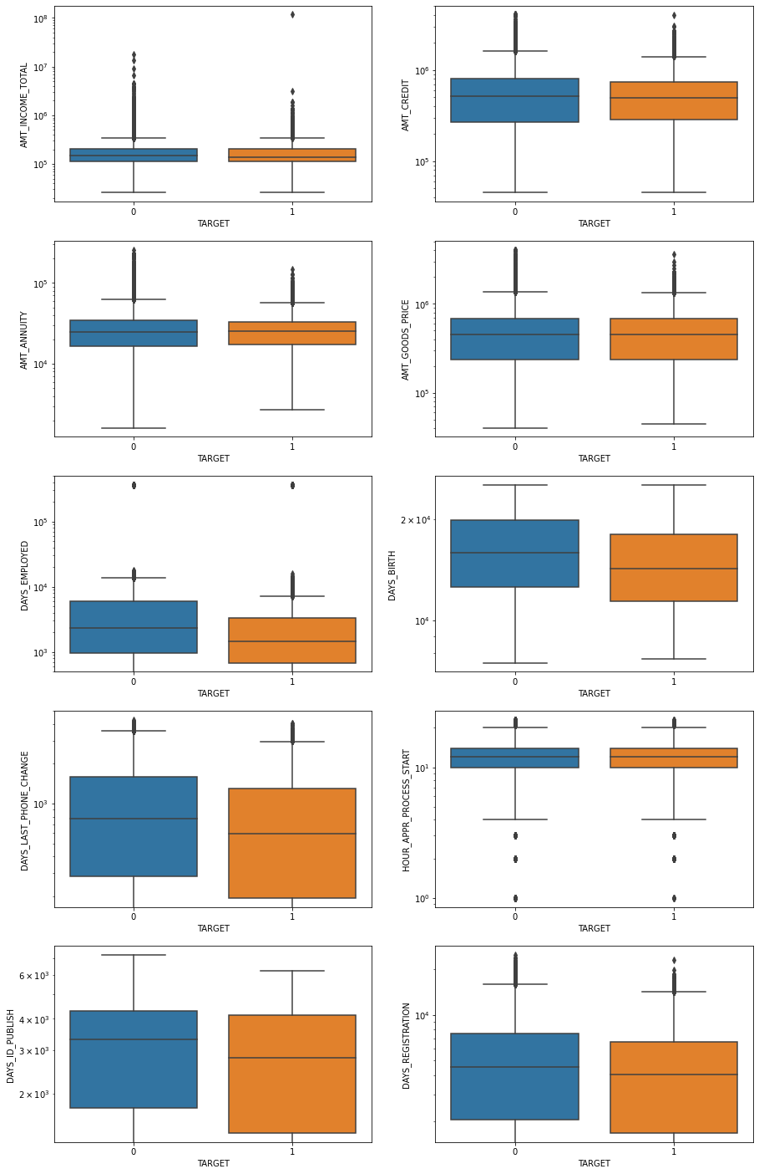
CONSIDERING 10 BI-VARIATE CONTINUOUS PLOTS
Few points can be concluded from the graph.
This shows the collage view for the easy comparision

Slide 17
Bivariate Analysis of Categorical-Categorical

Slide 18
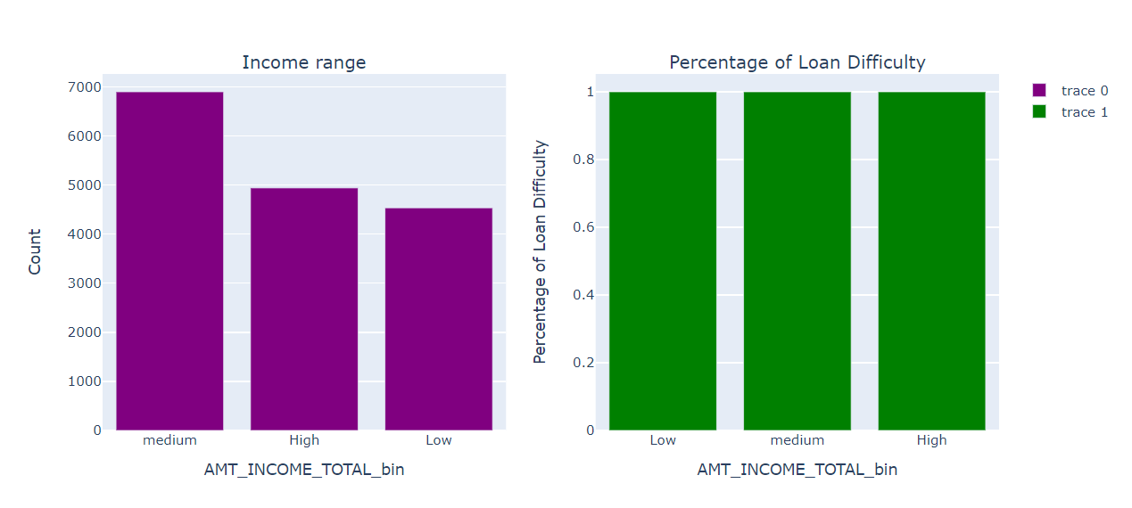
AMT_INCOME_TOTAL_bin

Slide 19
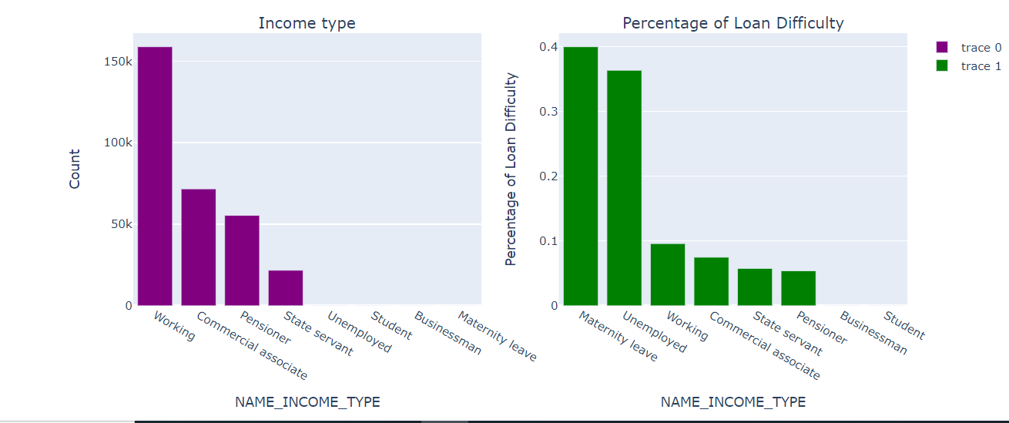
NAME_INCOME_TYPE

Slide 20
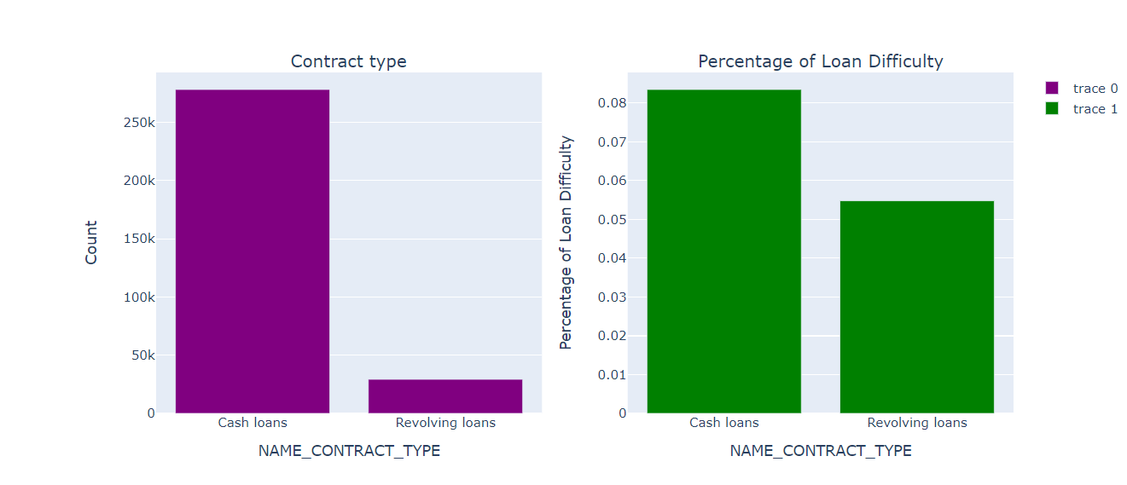
NAME_CONTRACT_TYPE

Slide 21
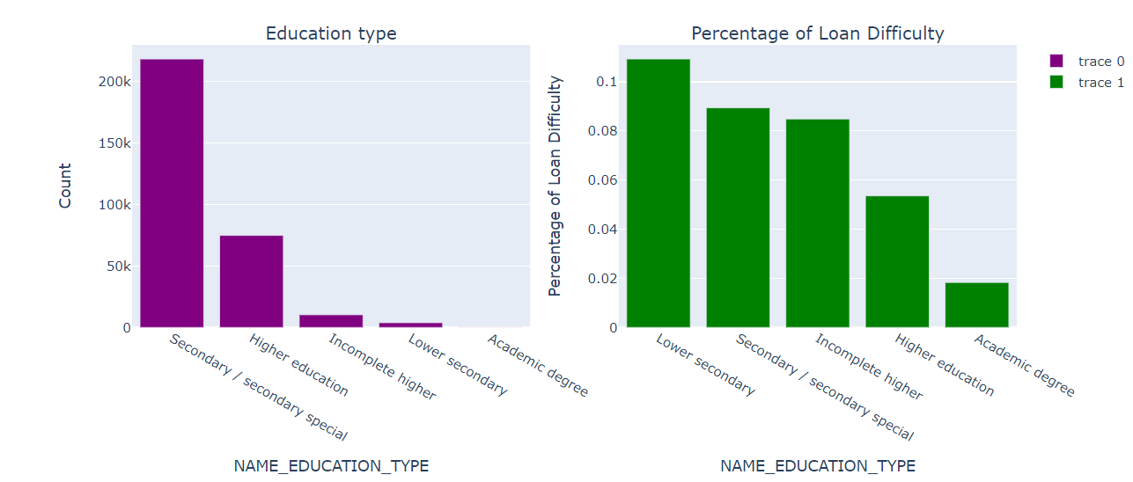
NAME_EDUCATION_TYPE

Slide 22
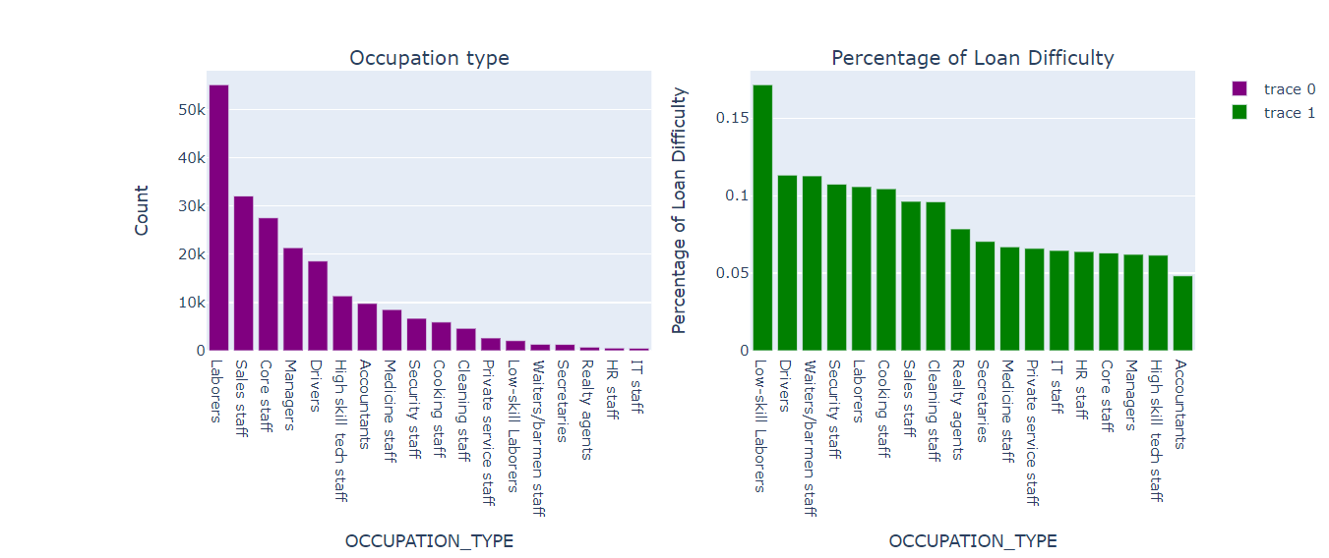
OCCUPATION_TYPE

Slide 23
Univariate analysis after merging previous data

Slide 24
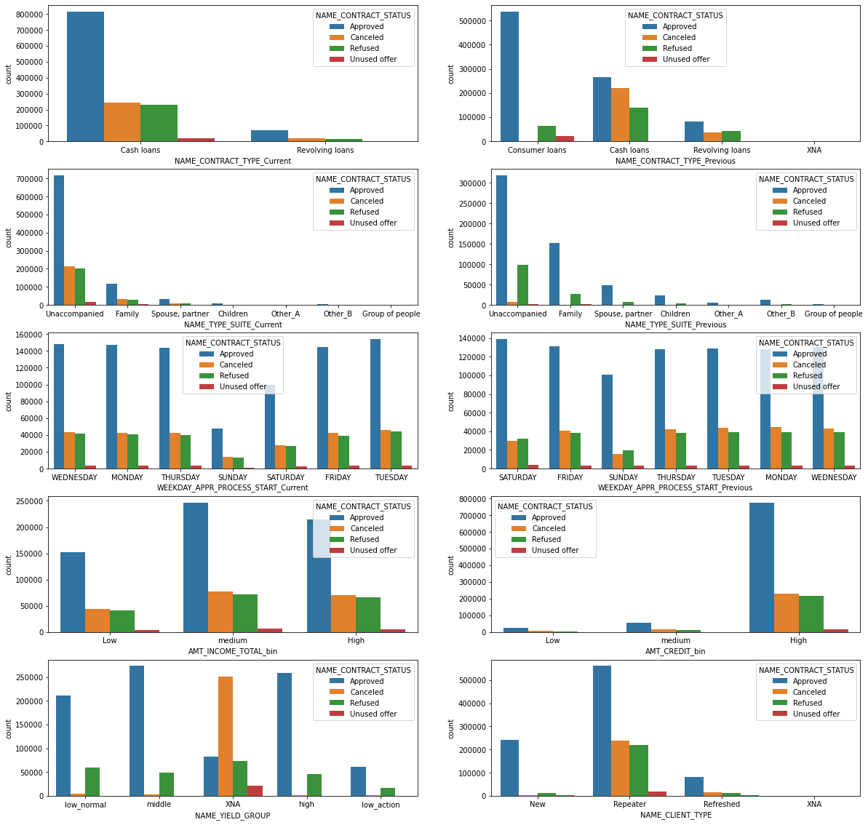
CATEGORICAL ANALYSIS
Few points can be concluded from the graph.
Repeater has highest number of approved loans.
Middle NAME_YIELD_GROUP has highest approval.
Value of AMT_CREDIT_BIN does not affect loan approvals.
For Medium AMT_INCOME_TOTAL_bin the approval is highest .
In previous application saturday has the highest approval rate.
Both in NAME_CONTRACT_TYPE_Previous and NAME_CONTRACT_TYPE_Current unaccompanied has the highest number.
currently bank is only giving two types of loans -Cash and Revolving Loans.
Previously bank was providing Cash, Revolving and Consumer loans.
Number of consumer loans were highest previously and now highest number is Cash loans.

Slide 25
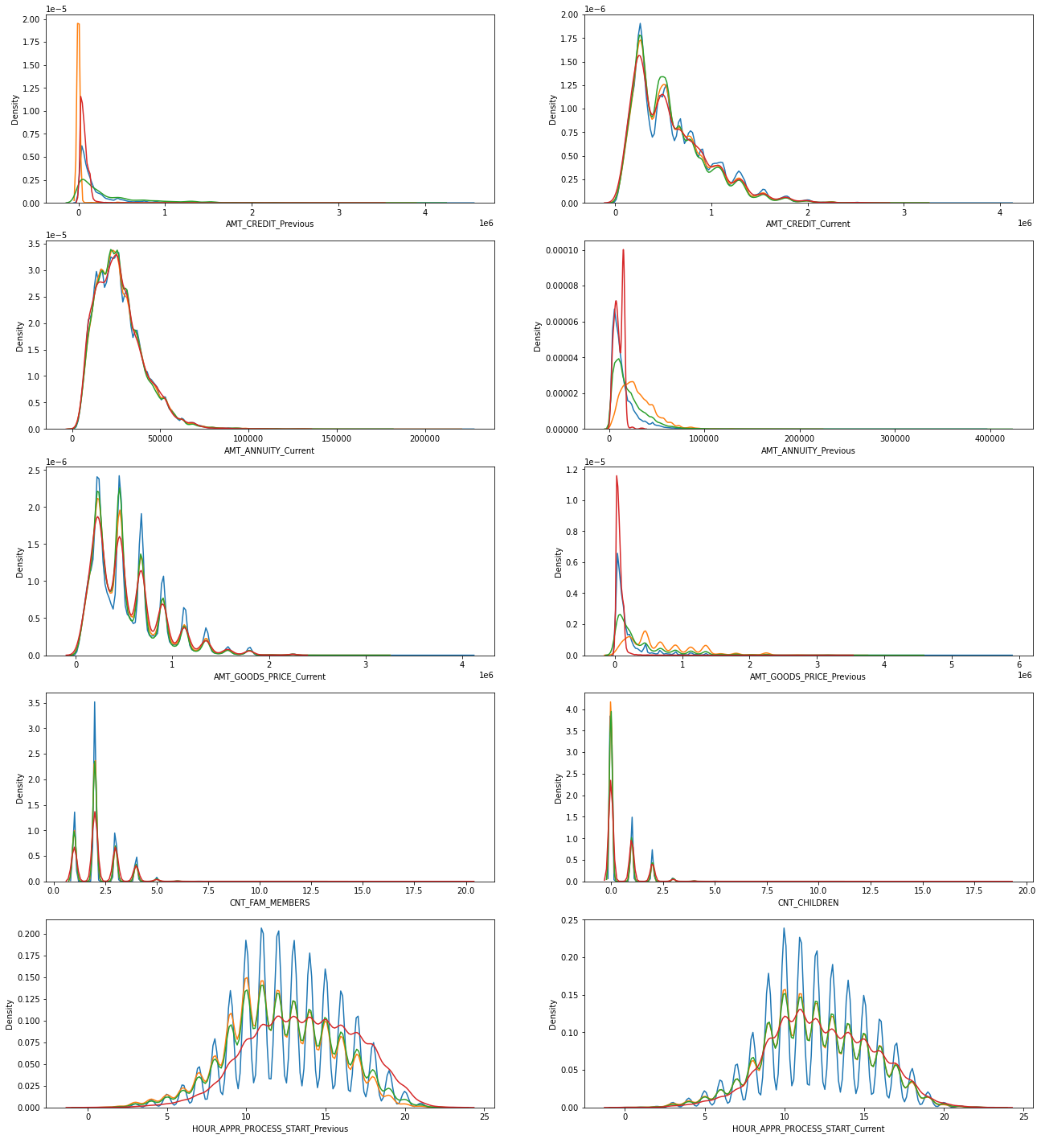
NUMERICAL ANALYSIS

Slide 26
Performing bivariate analysis

Slide 27
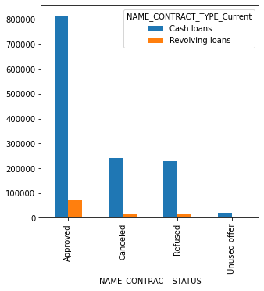
NAME_CONTRACT_TYPE_Current
Cash loans have the highest count of Approved loans in above plot

Slide 28
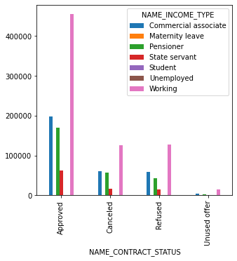
NAME_INCOME_TYPE
Highest number of approvals for working applicant

Slide 29
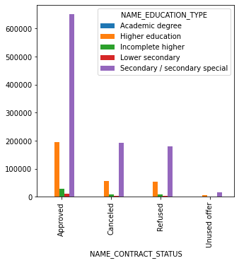
NAME_EDUCATION_TYPE
Few points can be concluded from the graph.
Highest number of approvals for Secondary/secondary special educated applicant.

Slide 30
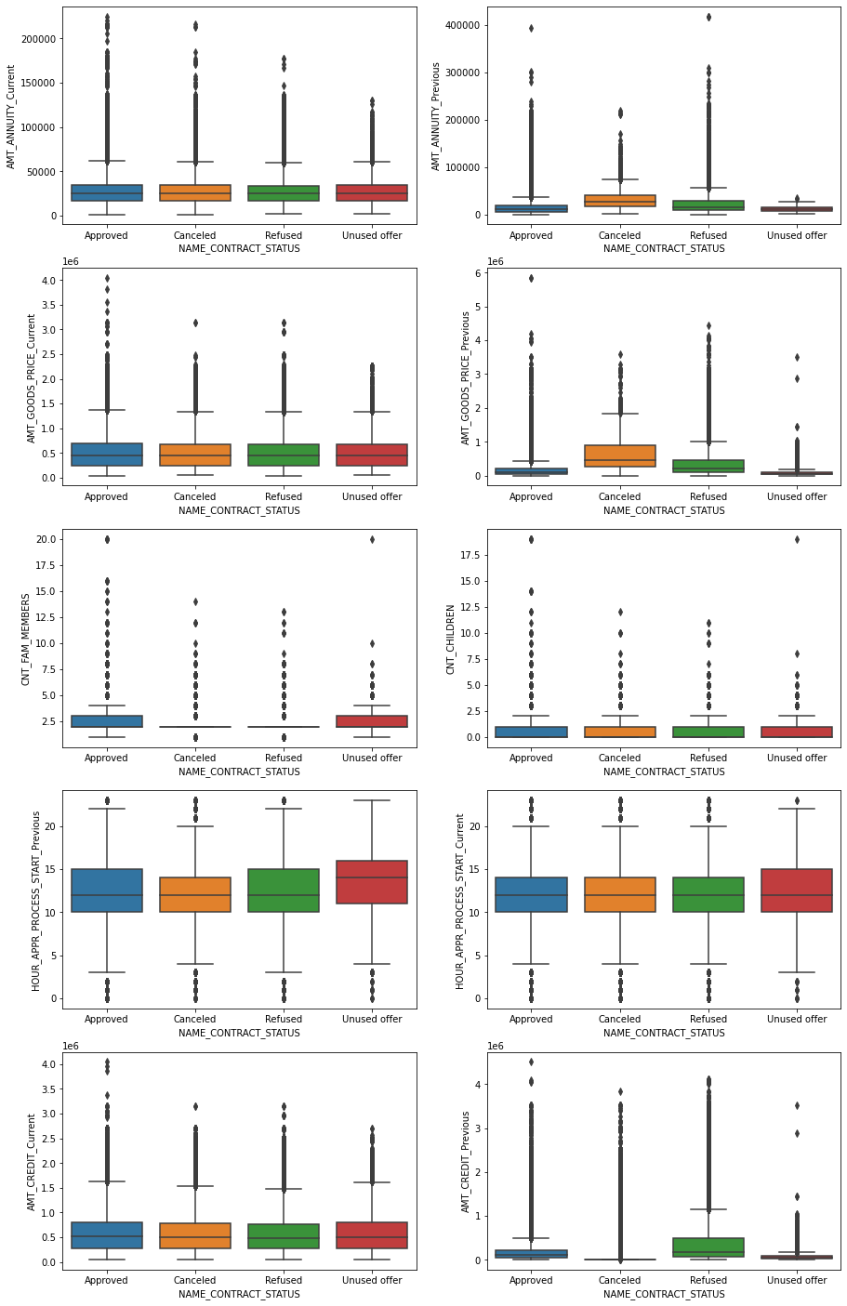
Continous/Numerical analysis

Slide 31
conclusion
AMT_CREDIT_Previous has highest refused cases and AMT_CREDIT_Current is similar for all 4 cases.
Time spent in unused offer is higher as compared to other categories.
So bank should reduce time spent on unused offer.
Nuclear family(2-3 people in family) get highest approval.
Previously most of the applications were cancelled or refused
But now Refused/Cancelled/Approved/Unused all four have similar situation for AMT_GOODS_PRICE.
Previously most of the applications were cancelled or refused
But now Refused/Cancelled/Approved/Unused all four have similar situation for AMT_ANNUITY.

Slide 32
Thank you

